Slide 1
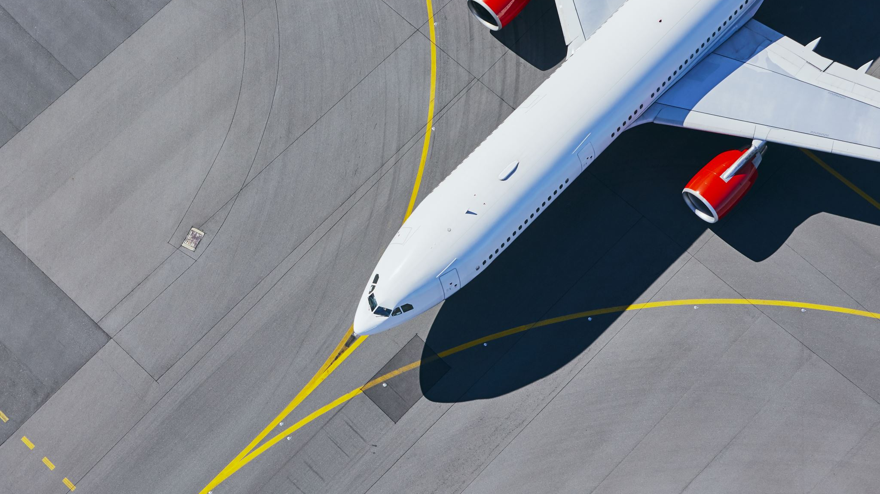
Plane Safety
By Matt Kline

Slide 2

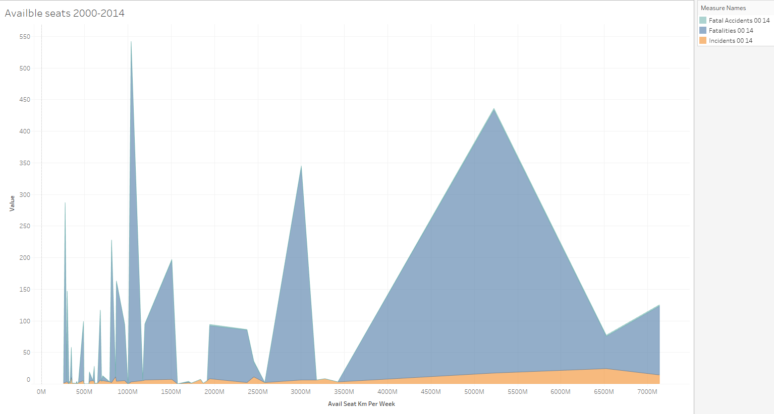
Looking at incidents in 2000-2014

Slide 3
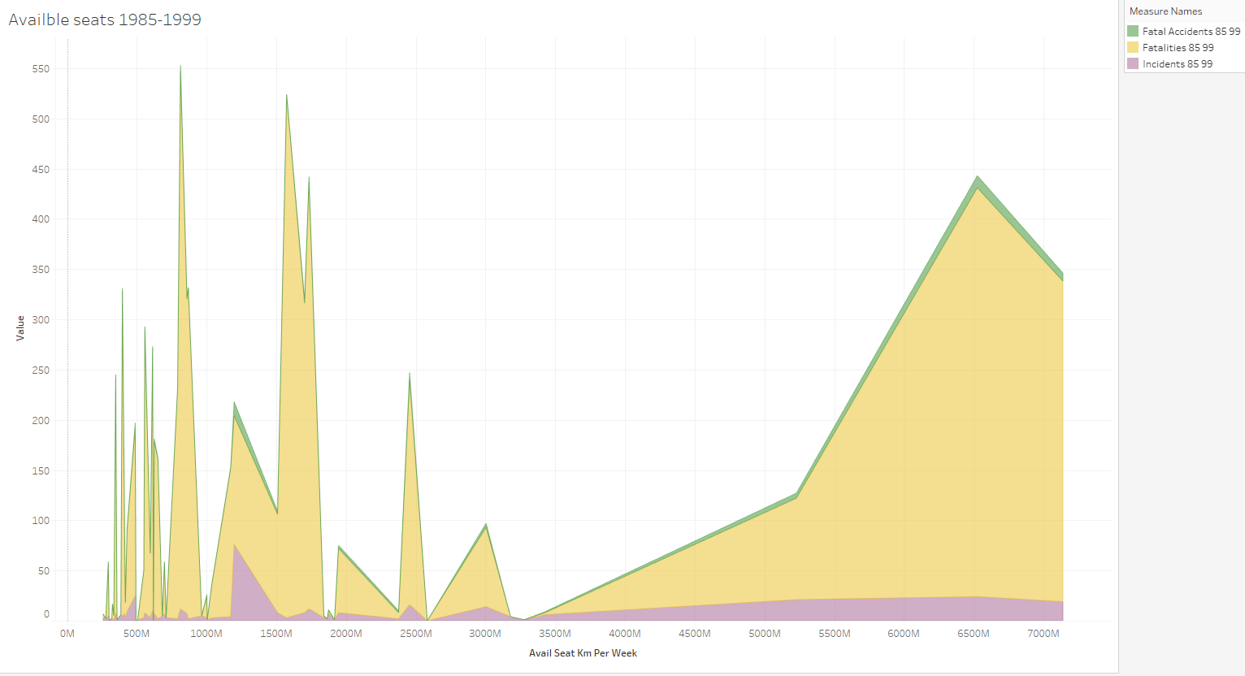
Similar image for the 1985-1999 timeline where we can see more spikes in insidents.

Slide 4
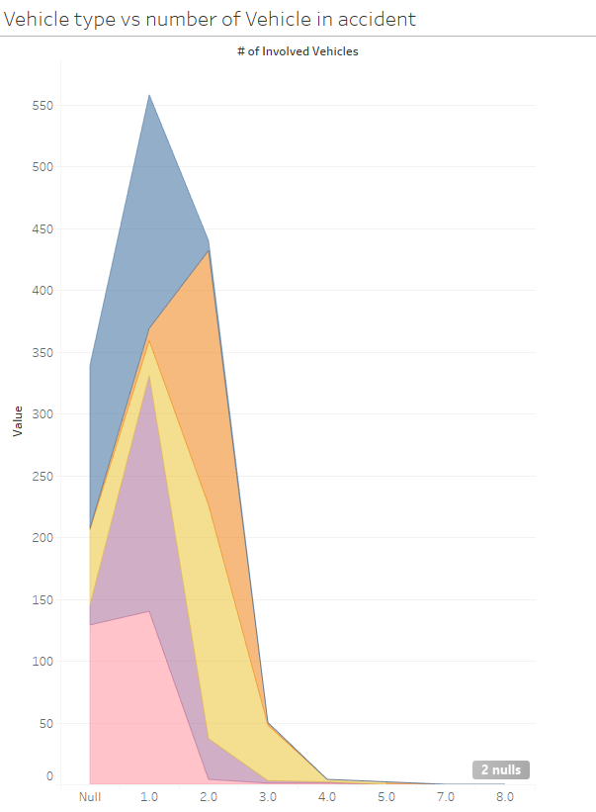
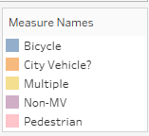
Types of other vehicle incidents
Here we can see all the different vehicles, including pedestrians, that have incidents on a daily basis. It's interesting to see that Bicycles have the most incidents resulting in injuries since they are not a motorized vehicle.

Slide 5
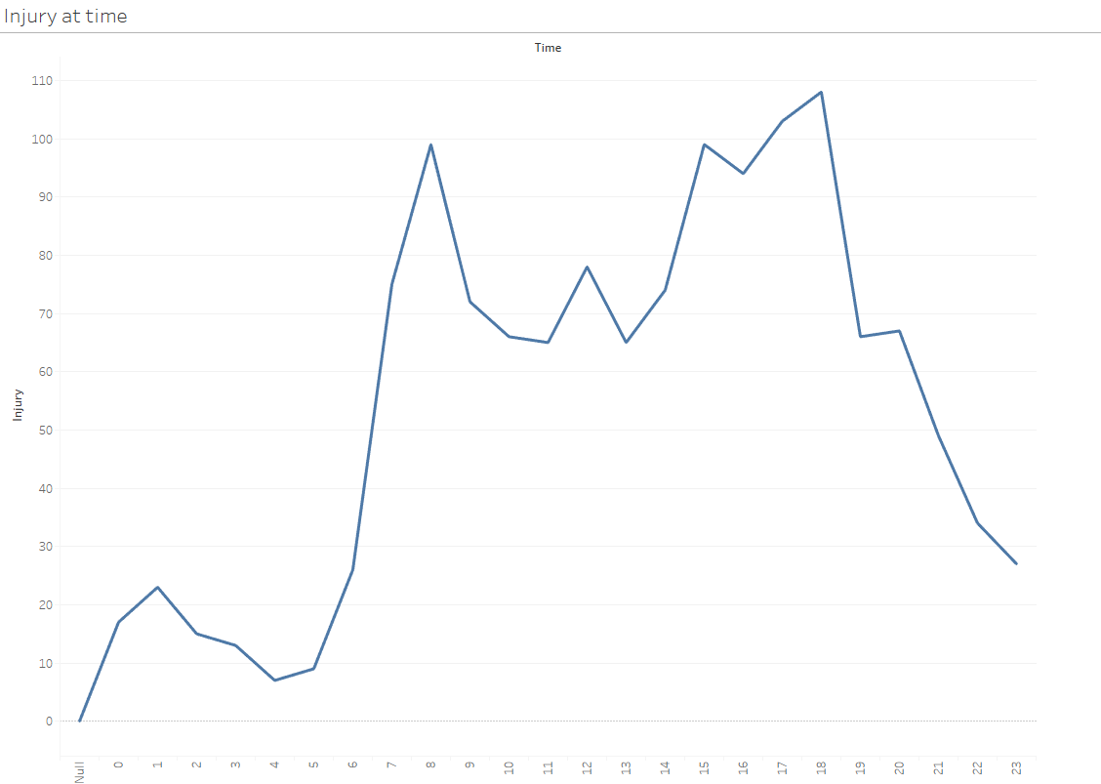
Normal vehicle accidents peak at the same time each day. During normal traveling hours you are at high risk then you would be traveling in a plane.

Slide 6
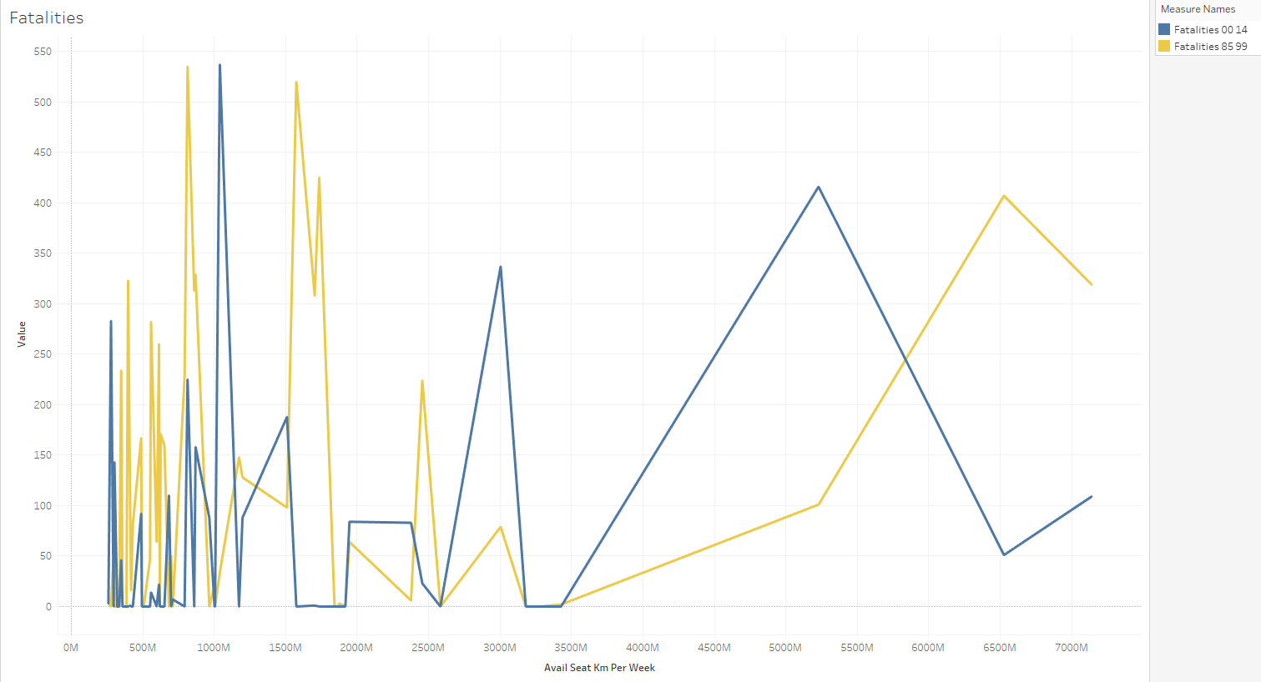
Fatalities caused by airplanes are consistently becoming lower and lower in the more current years. In the grouping of 1985-1999 we see much higher spikes in fatalities for the same available seats.

Slide 7
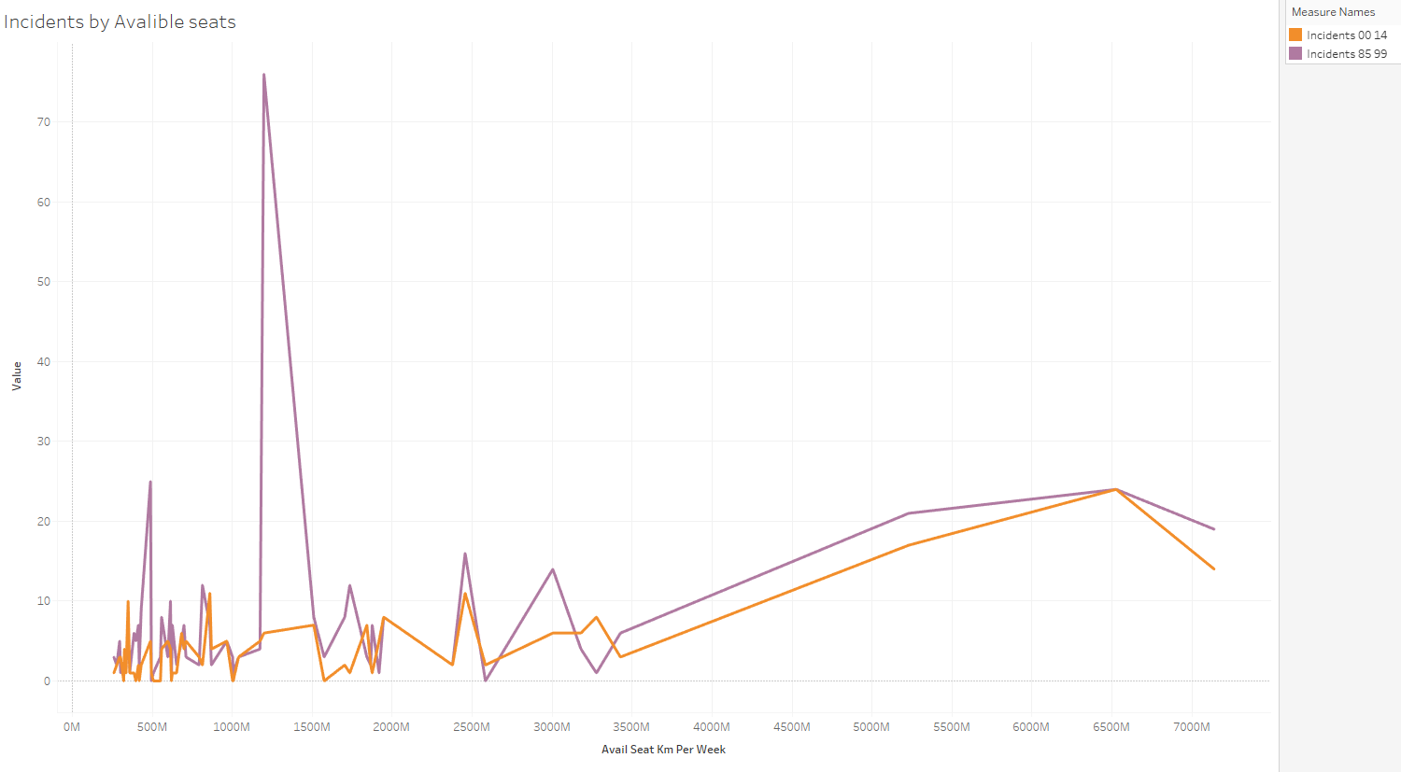
Like the previous image, we can see that all incidents, even ones without fatalities are lower in the more current years and this trend is likely to continue.

